Slide 1










GROUP 5
Lane Alignment - HMI Use Case
JYOTISMAN KIRTI PRAKASH : SLIDE (1-5)
PRINCE : SLIDE (6-7)
PPT done by : DEEPAK, SUMMA , USHA , VIKASH
Designing Human-Machine Interface for Lane Keeping Systems

Slide 2
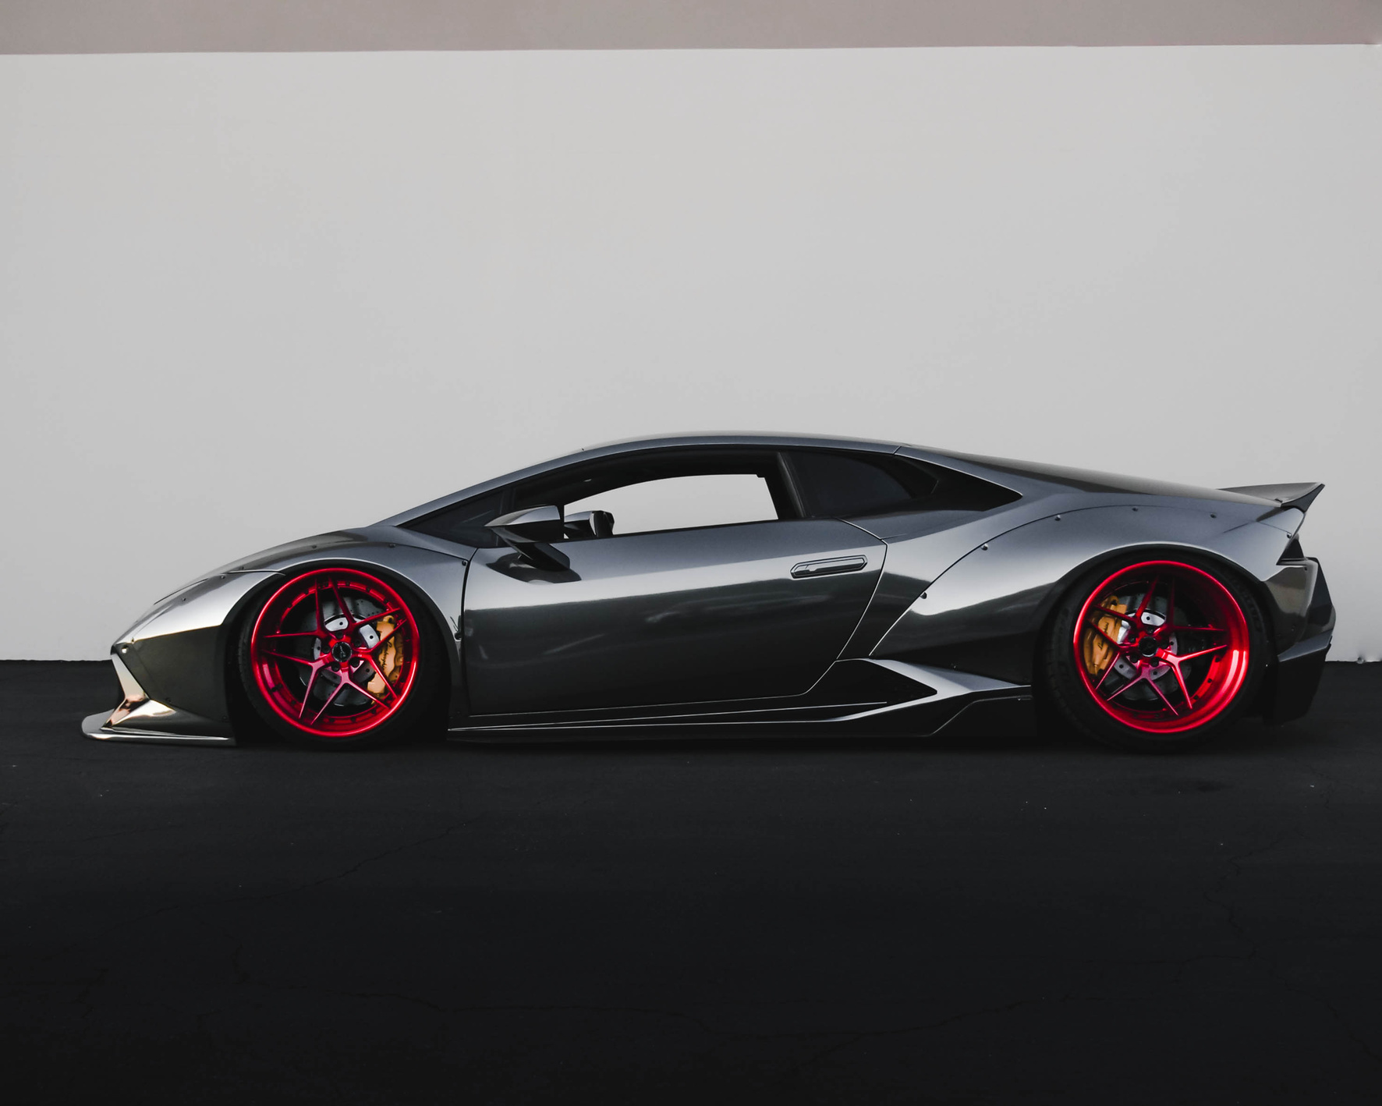

Use Case: Lane Alignments
OBJECTIVES
To assist the driver in maintaining proper lane alignment and to alert in case of unintentional lane departure.
KEY FUNCTIONS
Monitor lane position in real-time using sensors and cameras
• Provide visual, auditory, and haptic feedback to the driver

Slide 3
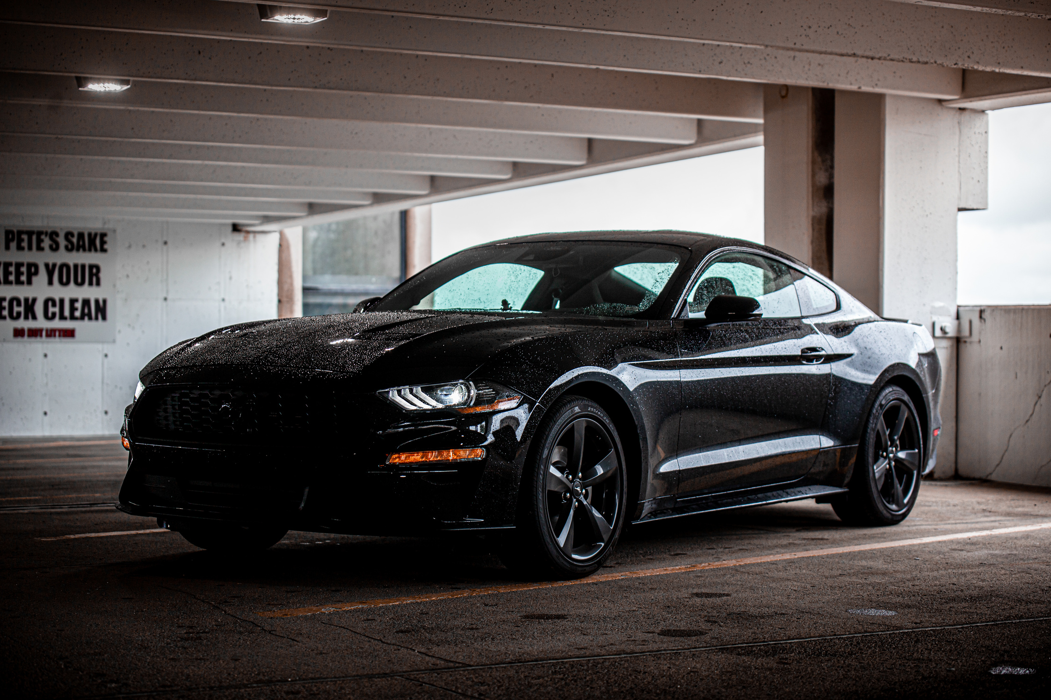

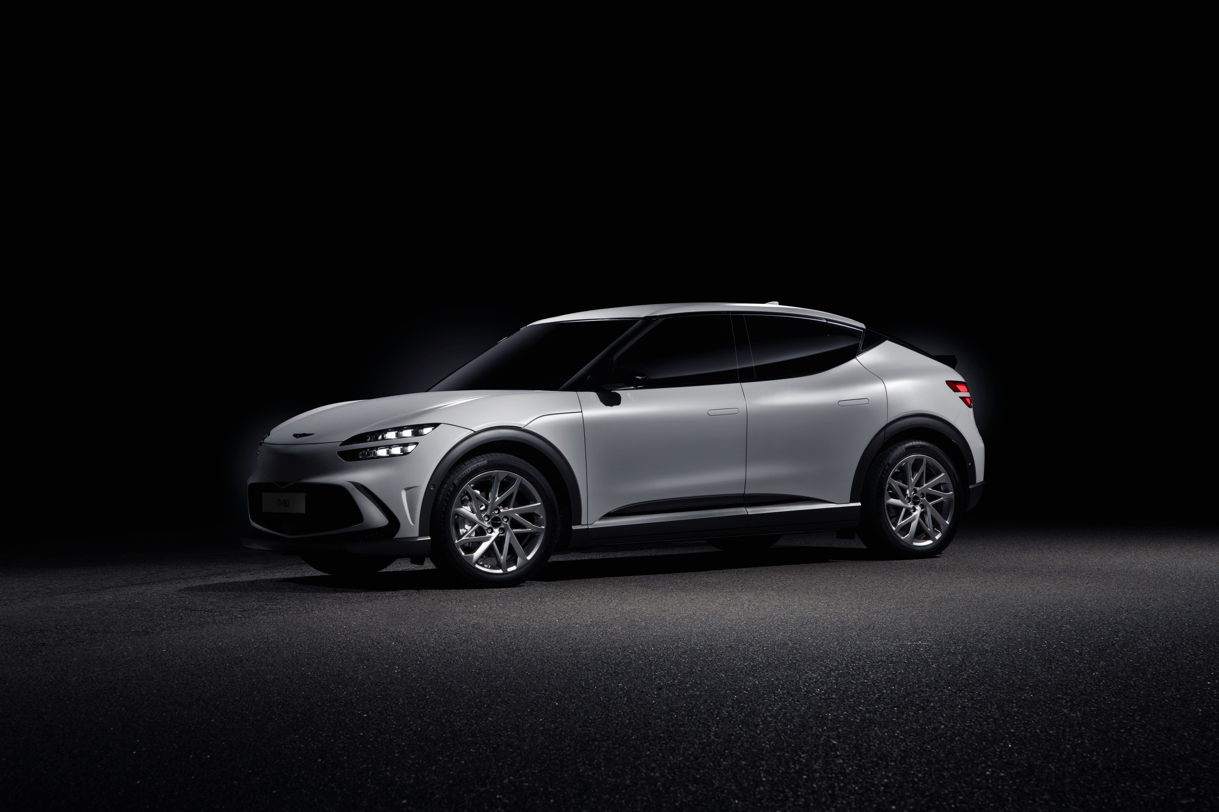
HMI Components
DIGITAL INSTRUMENT CLUSTER
Displays lane position and warnings
HEAD-UP DISPLAY (HUD)
TYPE A
TOUCH SCREEN CONSOLE
Shows real-time lane indicators on windshield
User settings for lane assist system
TYPE B
TYPE C

Slide 4
HMI SYSTEM STATES
NORMAL LANE ALLIGNMENT
• Lane lines green, vehicle centered
• Message: 'Lane Stable'
01
LANE DEPARTURE
• Lane lines red, strong alert & vibration
• Message: 'Caution! Lane Departure'
03
SLIGHT DRIFT DETECTED
LANE ASSIST ACTIVE
• Lane lines yellow, gentle vibration
• Message: 'Lane Drift Detected'
02
• Auto-steering enabled
• Message: 'Lane Assist Engaged'
04

Slide 5
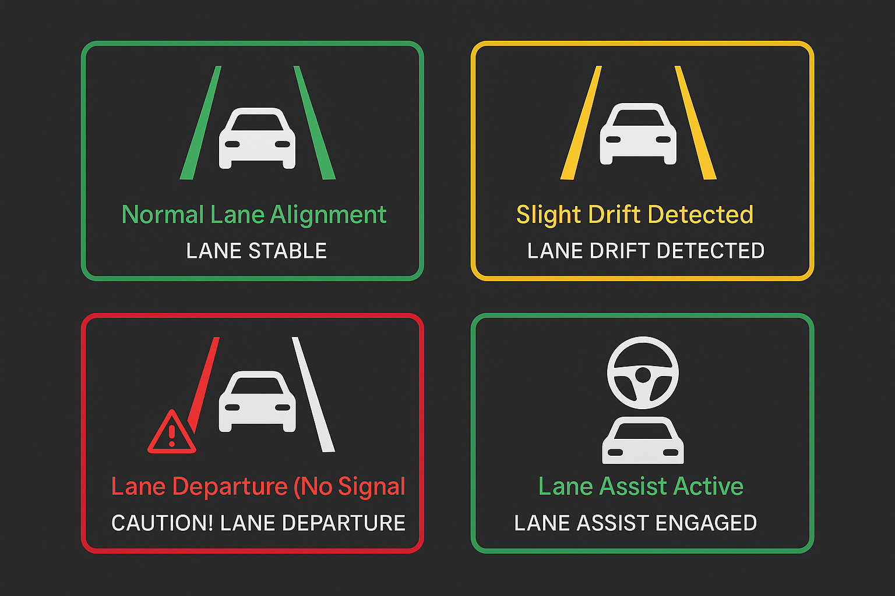

Slide 6

FLOW CHART
+------------------------+
| Camera Sensor Input |
+------------------------+
|
v
+------------------------+
| Lane Detection Logic | <-- Application Service SWC
+------------------------+
|
v
+------------------------+
| Drift Analysis |
+------------------------+
|
v
+------------------------+
| Application Controller | <-- Maps logic to HMI
+------------------------+
|
v
+------------------------+
| UI Device SWC | <-- Display, buzzer, vibration
+------------------------+
|
v
+------------------------+
| Driver Feedback |
+------------------------+

Slide 7

THANK YOU
THANK YOU!

